Slide 1
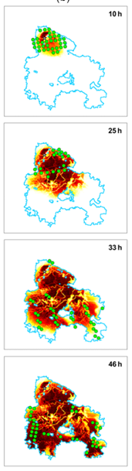
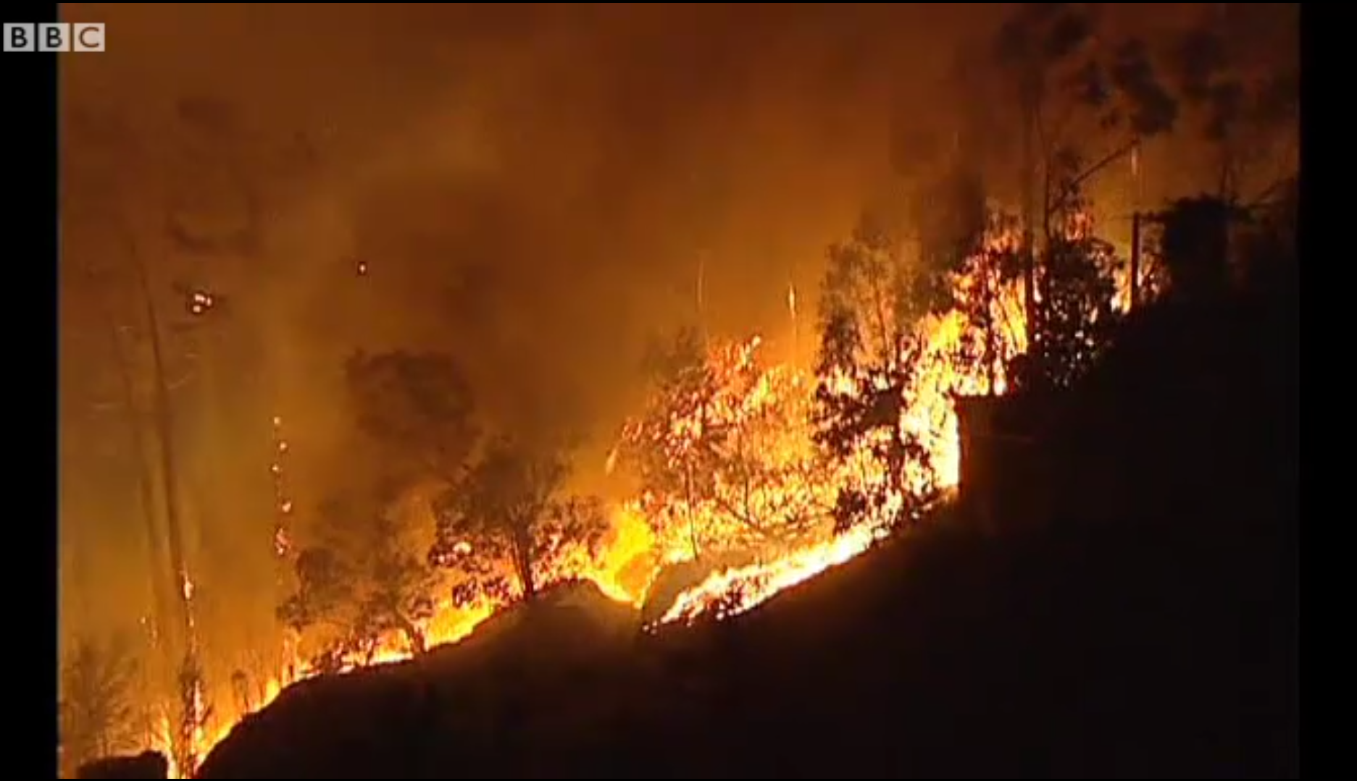
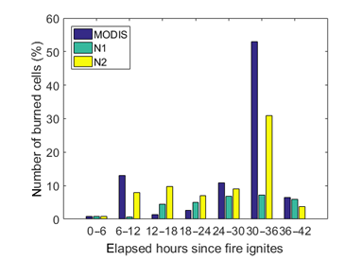

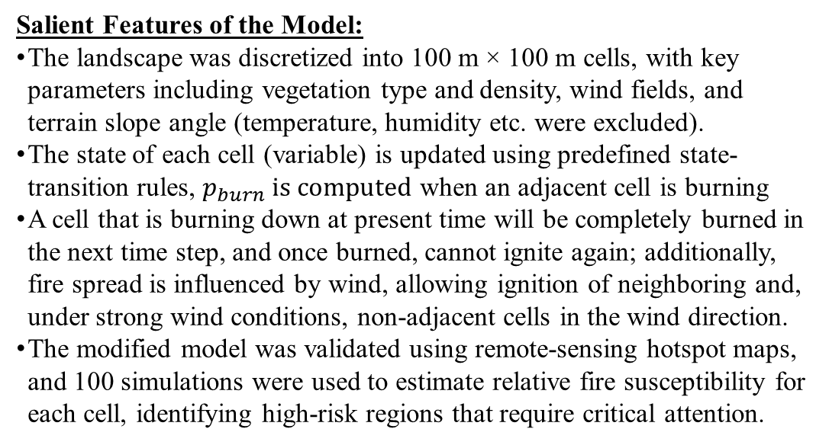
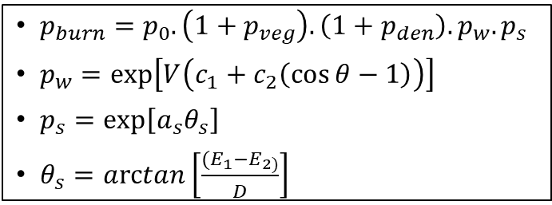
Modelling Wildfire Propagation Using Cellular Automaton For Fire Management
This model uses a simple cellular automaton (CA) to rapidly simulate wildfire propagation in Mediterranean landscapes and to generate risk probabilities (likelihood of a region burning) that aim to support fire management decisions and resource allocation.
[The well-documented data from the Tavira wildfire (July 2012) was used to refine and modify an existing model, improving its accuracy.]
Aspects of the Model:
Dynamic: Model outputs system evolution over time, and explains transient behavior
Discrete-time: The model uses time steps of 20 minutes (no output between t_{i} and t_{i+1})
Mechanistic: Model is based on mechanistic principles, with explanatory capability
Stochastic: The fire spread is probabilistic, same input may produce different outputs
Single-Scale: A single spatial and temporal scale is utilized in this model
$p_{burn}=p_{0}.\left(1+p_{veg}\right).\left(1+p_{den}\right).p_{w}.p_{s}$
$p_{w}=exp\left[V\left(c_{1}+c_{2}\left(\cos{θ}−1\right)\right)\right]$
$p_{s}=\exp\left[a_{s}θ_{s}\right]$
$θ_{s}=arctan\left[\frac{{(E}_{1}−E_{2)}}{D}\right]$
Salient Features of the Model:
The landscape was discretized into 100 m × 100 m cells, with key parameters including vegetation type and density, wind fields, and terrain slope angle (temperature, humidity etc. were excluded).
The state of each cell (variable) is updated using predefined state-transition rules, $p_{burn} is computed$ when an adjacent cell is burning
A cell that is burning down at present time will be completely burned in the next time step, and once burned, cannot ignite again; additionally, fire spread is influenced by wind, allowing ignition of neighboring and, under strong wind conditions, non-adjacent cells in the wind direction.
The modified model was validated using remote-sensing hotspot maps, and 100 simulations were used to estimate relative fire susceptibility for each cell, identifying high-risk regions that require critical attention.
Percentage of total burnt cells vs time from active fires, normal and modified models.
Fire spread in the modified model. The heatmap indicating the percentage of burnt cells.
Using cellular automata to simulate wildfire propagation and to assist in fire management, Nat. Hazards Earth Syst. Sci., 19, 169–179, https://doi.org/10.5194/nhess-19-169-2019

